Slide 1

Requirements Management
Notes:
‹#›

Slide 2




Major Areas of Requirements Management
Traceability
Planning for Change
Methodology
Tools
Notes:
‹#›

Slide 3
Requirements Management
Requirements Trace To Many Project Elements
Business
Vision /
Roadmap
Everybody depends on it!
Project Plans
Informal
Requirements
SRS
Requirements
Analysis
Feasibility/Cost
Analysis
Contract(s)
Users
Customers
Business
Stakeholders
Requirements
Analysts
QA
Architect

Slide 4
Requirements Change
Change is Risk!
Customer’s biz environment may change (Mutable)
New requirements as understanding evolves (Emergent) (this is one of the problems with waterfall)
Users may want something new or different after they see the initial system (Consequential)
Users always find “their own way” of working with a system most productively after delivery (Adaptive)
Current user base must be supported during rollout (Migration)
The priority of requirements may change during the development (or other downstream) process
First 5 of these attributed to Harker et. Al. 1993
Change may be a risk, but it is a truism - it will happen!

Slide 5
Requirements Management Maturity
Level 0: Chaos! No Requirements
Missing/unneeded functionality, poor quality
Level 1: Written Requirements
Basis for a contract with the customer
Basis for a contract with your implementation team
Basis for integrating new additions to your team
Level 2: Organized
Requirements identification, persistence & versioning
Format and security
Quality of the requirements
These 5 levels from the Heumann (RUP) whitepaper

Slide 6
Requirements Management Maturity
Level 3: Structured
Create reqs taxonomy (system of classification)
Functional/Non/Domain, Functional/Design Constraint, Mutable/Emergent/Consequential/Adaptive/Migration, User/System, Enduring/Volatile, etc.
Use requirements metadata
Describe state (identified, defined, stable, accepted), priority (must have, nice to have, etc.), dependencies (parent-child, depends-on, includes, extends, etc.), owner/sponsor
Level 4: Traced
Upward: where did the requirement come from & why?
Downward: what resources do we allocate to do it?
The basis for verification and validation

Slide 7
Requirements Management Maturity
Level 5: Integrated
Using requirements to drive your full process
No requirements changes made w/out review
Requirements should also drive project management
Implication: you cannot maintain a fully integrated RM process without a sophisticated tool.
Possibly in-house, possibly COTS with lots of integration

Slide 8
Requirements Management Planning
Planning during the requirements process:
Requirements identification
How requirements are individually identified and stored
Requirements organization
Functional/Non Functional, Enduring/Volatile, etc.
Change Request Management (CRM) process
The process followed when wanting to change a requirement after the SRS baseline has been established
Can have branched requirements!
Traceability policies
The amount of information about requirements relationships that is maintained
CASE tool support – Computer Aided Software Eng
The tool support required to help manage requirements change

Slide 9
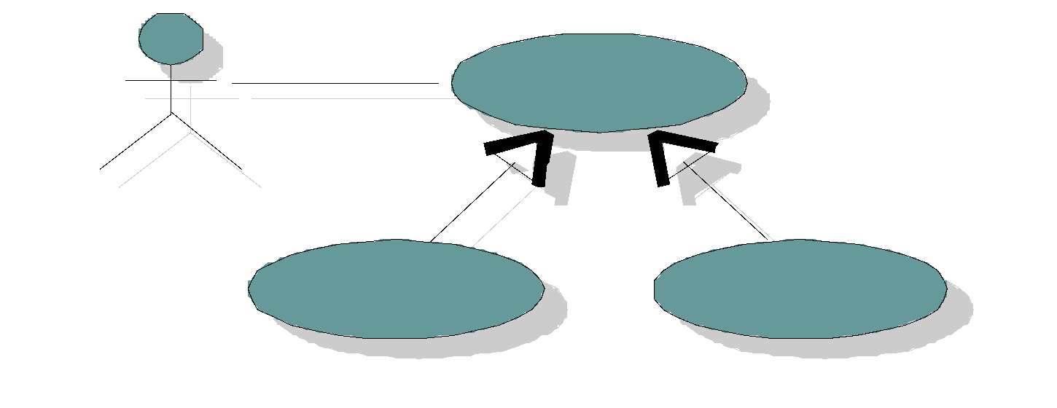
Requirements Identification
Requirements require “ground truth”
Everyone needs to point to the same place and say:
“There are the requirements, and I mean that one”
Requirements need a place to persist & be identified
Including versioning, change history, and state
Requirements
Database
Queries and Reports
Documents and Attributes

Slide 10
Requirements Organization
Enduring requirements
Stable requirements derived from the core activity of the customer organisation.
e.g. a hospital will always have doctors, nurses, etc.
May be derived from domain models
Volatile requirements
Requirements which change during development or when the system is in use.
e.g. In a hospital, requirements derived from health-care policy
Classifying may help mitigate scope of impact

Slide 11
Change Request Management
Customer and User input
Single Channel
for Approval
New Feature
Req
New
Requirement
Design
Marketing
Approved Decision Process
Change
Control Board
(CCB)
Coders input
Testers input
Bug
Code
Change Request (CR)
Test
Help Desk
User input
Maint
Weinberg, ‘95
Best Practice: Use a CCB to serve as a centralized Product Management oversight committee that can understand the broader impact of a change.
Made up of a cross-section of stakeholders at all levels
Problem: potential bottleneck!

Slide 12
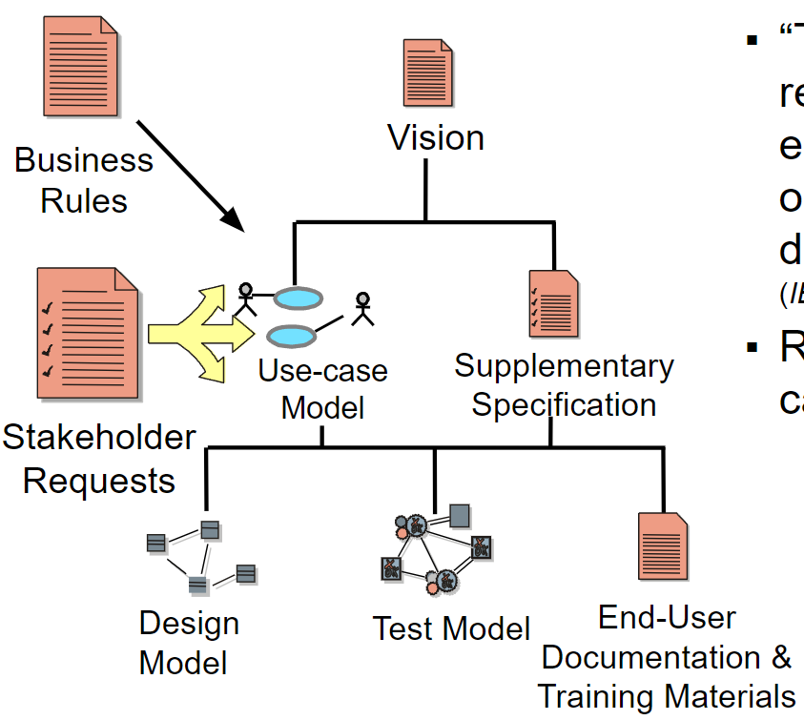
Traceability
“The degree to which a relationship can be established between two or more products of the development process” (IEEE-610.12-1990)
Requirements artifacts can be modeled
Example relationships: Predecessor-successor, Parent-child
Issue: How big do you want the process to get?!

Slide 13
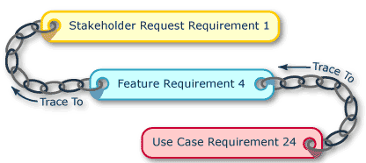
Traceability
Why is it so important?
Quality
Can we determine if the requirement is validated?
Can we determine if the requirement is verified?
Impact Analysis
Do we know what other requirements are affected?
Do we know what people are affected?
Users, Customers, Biz stakeholders, Coders, …
Do we know what downstream artifacts are affected?
Design, Tests, Training documents, Sales literature, Code (!)
Do we know what the change would cost?
Without it, we could not execute a CRM Process!

Slide 14
CASE Tools
Requirements Management is hard!
Suggests a database engine
But also consider where information comes from:
Meeting minutes, phone calls, emails, chat transcripts, etc.
How to you track all this stuff and what is important?
“Heavy” processes supported by “heavy” tools
Tools do a lot of the lifting
Still need a well-defined process to get information into the tool and keep it “clean”
Lightweight processes
Just not worth the overhead and cost
Save the CCB for defects, and force customers to migrate forward to minimize scope of change
Tools include Wikis, spreadsheets, whiteboards, and shared BOK

Slide 15
Change Management Processes
Leffingwell & Widrig suggest a 5-step CM process:
Recognize change is inevitable, and plan for it
“Embrace change” is the new mantra of software organizations – how you can deal with it while maintaining project momentum?
Baseline the Requirements (use version control!)
The acceptance of your SRS & SDP represents your baseline
Establish a single channel to control change
This is what a CCB is for. Envision what will happen if every team member and every project sponsor is allowed to cause change?
Use a change control system
You have various ways – document revision histories, spreadsheets, code repositories, issue trackers, … how will you use?
Manage change hierarchically
See traceability slide, or think of your pyramid!

